Slide 1
Capstone Engagement
Assessment, Analysis, and Hardening of a Vulnerable System
Presented by Phi-Huynh Nguyen

Slide 2
Table of Contents
This document contains the following sections:
01
Network Topology
02
Red Team: Security Assessment
03
Blue Team: Log Analysis and Attack Characterization
Hardening: Proposed Alarms and Mitigation Strategies
04

Slide 3
Network Topology
‹#›

Slide 4
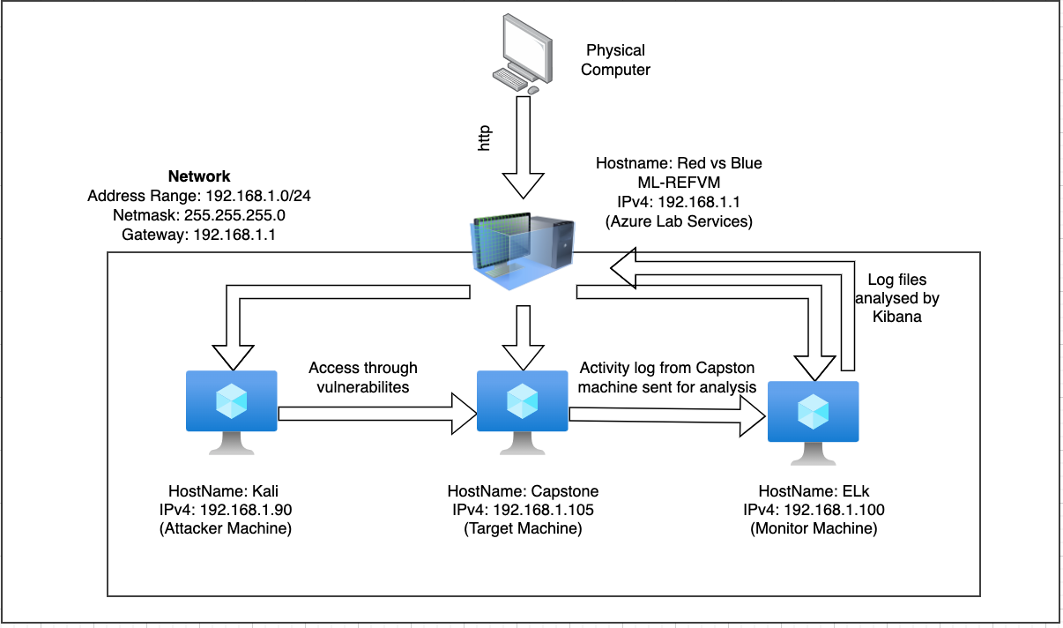
Network Topology
Network
Address Range: 192.168.1.0/24
Netmask: 255.255.255.0
Gateway: 192.168.1.1
Machines
IPv4: 192.168.1.90
OS: Kali Linux
Hostname: Kali
(Attacker)
IPv4: 192.168.1.100
OS: Linux
Hostname: ELK
IPv4: 192.168.1.105
OS: Linux
Hostname: Capstone
(Victim)
IPv4: 192.168.1.1
OS: Windows
Hostname: Red vs Blue -
ML-REFVM
[Insert Here]
Use draw.io to create a diagram of the network.
Add your diagram to this slide and fill out the data in the sidebar.

Slide 5

Red Team
Security Assessment
‹#›

Slide 6
Recon: Describing the Target
Nmap identified the following hosts on the network:
Hostname | IP Address | Role on Network
Red vs Blue ML-REFVM-684427 OS Window | 192.168.1.1 | Host Machine that will displaced log datas
Kali (Attack VM) OS Kali Linux | 192.168.1.90 | Attack Virtual Machine
ELK (Monitor) OS Linux | 192.168.1.100 | Monitor Machine that capture logs activity data from Capstone machine
Capstone (Target VM) OS Linux | 192.168.1.105 | Target machine with vulnerabilities

Slide 7
Vulnerability Assessment
The assessment uncovered the following critical vulnerabilities in the target:
Vulnerability | Description | Impact
Open Port 80 | Open ports allowed hackers an exploitable access to private information and increase risk of data breach. | Allowed hackers (Red Team) to be able to access private informations.
Accessible Files | Web servers, FTP servers, and other similar accessible servers store a set of files in a “root” directory that is accessible to server’s users. | Allowed hacker to view files after gaining access to the IP on port 80 from a web browser.
Brute Force Password | Common used password that can be find in a brute force wordlist. | Allowed hacker to brute force Ashton’s password, and access to the secret files in the system.
Hashed Password | Hashed password can be cracked through different software(John the Ripper, hashcat, also online tools). | Using hashcat to identify password for Ryan.
WebDav Vulnerability | Exploit WebDav on a server and gain access to drop shell command. | Allowed Redteam to remotely modify website content.

Slide 8
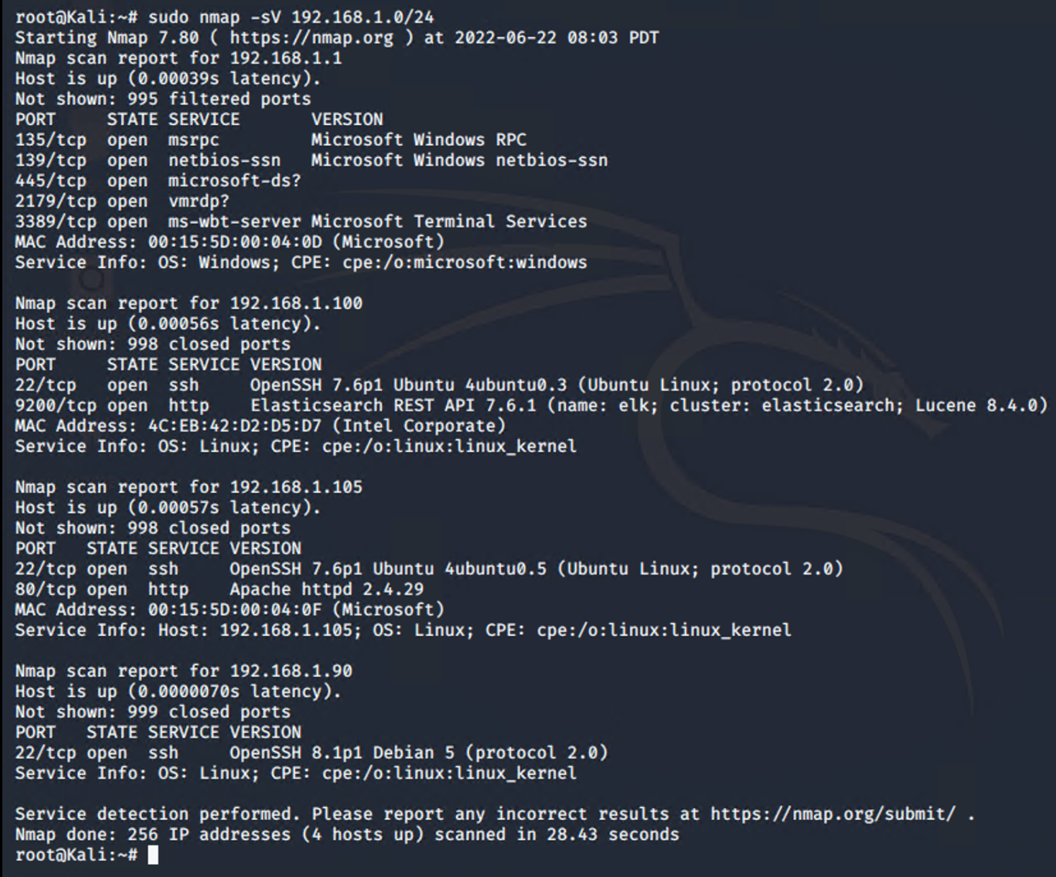
Exploitation: Open Port 80
01
02
03
Tools & Processes
Used nmap to scan for any open ports and services in 192.168.1.0/24
# sudo nmap -sV 192.168.1.0/24
Achievements
Found that IP address 192.168.1.105 has an open port 80, gaining access to a directory with information on privates files.

Slide 9
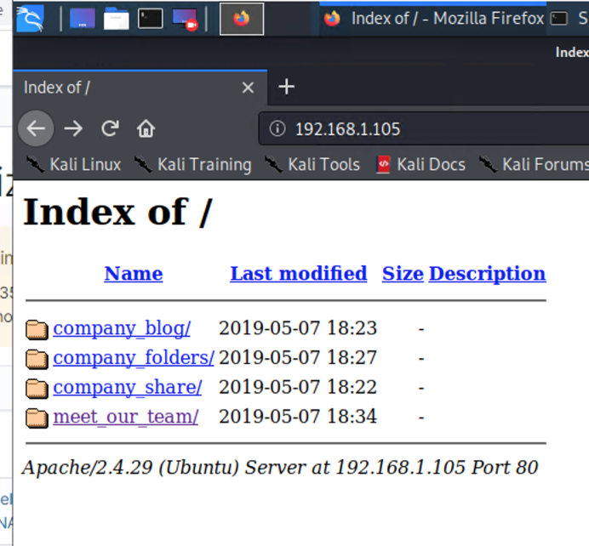
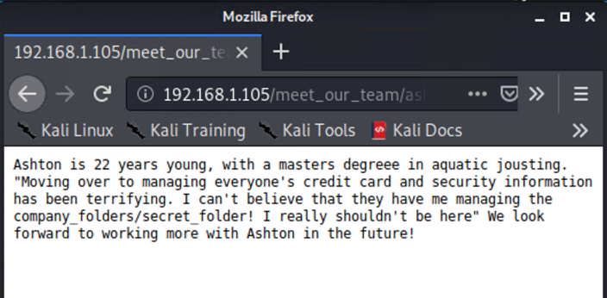
Exploitation: Accessible Files
01
02
03
Tools & Processes
Using open port 80, Red Team opened a web browser with the root index for 192.168.1.105
Achievements
Navigating the files led the Red team to uncover which users had access to secured files and where the company secret files is located.

Slide 10
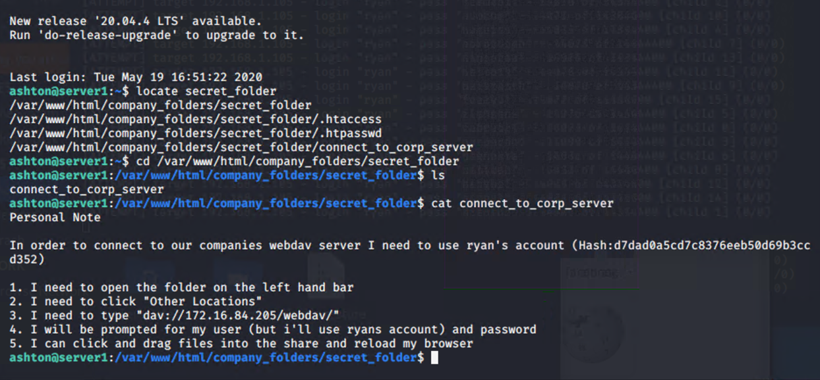
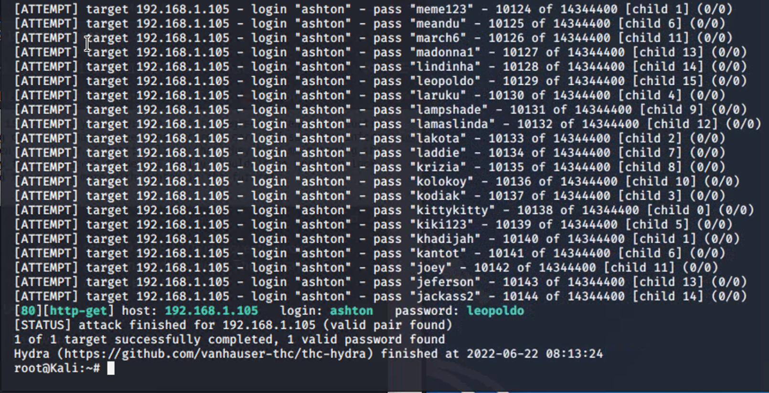
Exploitation: Brute Force Password
01
02
03
Tools & Processes
Using Hydra, the Red Team was able to brute force Ashton’s password using rockyou.txt (common used password lists)
Achievements
Able to uncover Ashton password thus granting user shell access into the company servers.

Slide 11
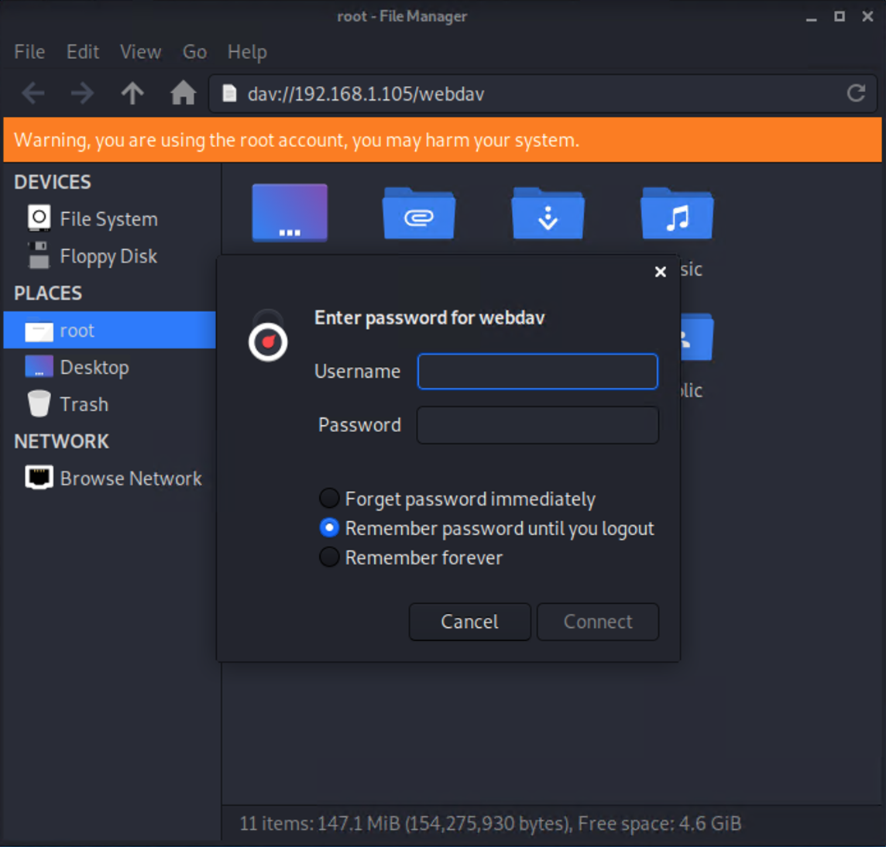
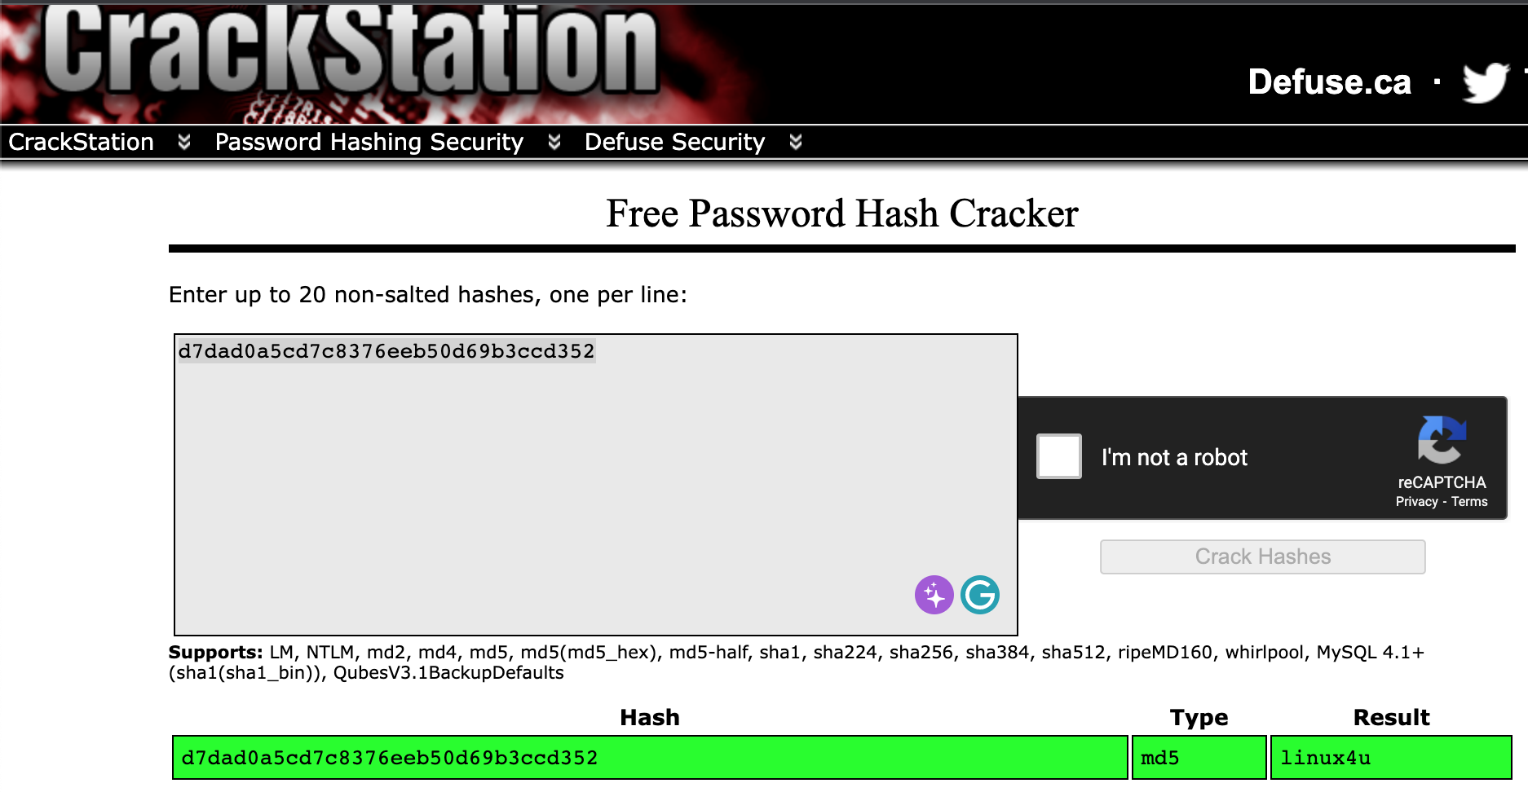
Exploitation: Hashed Password
01
02
03
Tools & Processes
Using www.crackstation.net, the Red Team was able to find the plain text for the hashed password of Ryan
Achievements
Ryan account granted the Red Team access to the system through the WebDav connection.

Slide 12
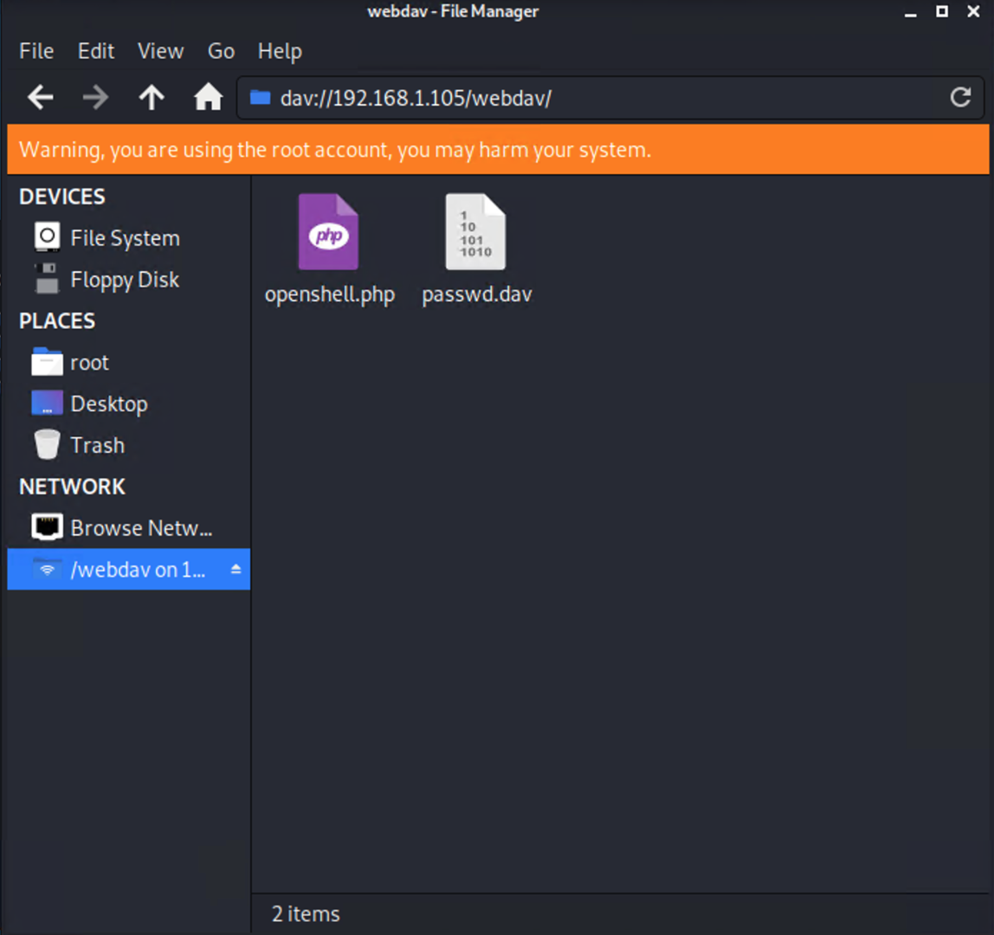
Exploitation: WebDav Vulnerability
01
02
03
Achievements
This then allowed a quicker way of injecting malware unto the company server.
Tools & Processes
Once the passwords was cracked, it was easy to log into the company server remotely due to WebDav.

Slide 13

Blue Team
Log Analysis and Attack Characterization
‹#›

Slide 14
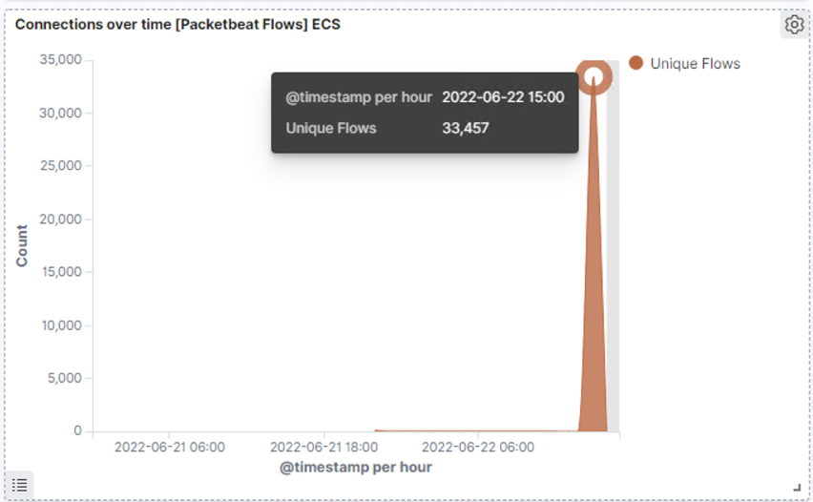
Analysis: Identifying the Port Scan
The port scan began on June 22, 2022 around 3pm.
33,457 connections occurred at the peak with the source IP 192.168.1.90
A high peaks in network traffic indicate that this was a port scan.
[Insert Here]
Include a screenshot of Kibana logs depicting the port scan.

Slide 15
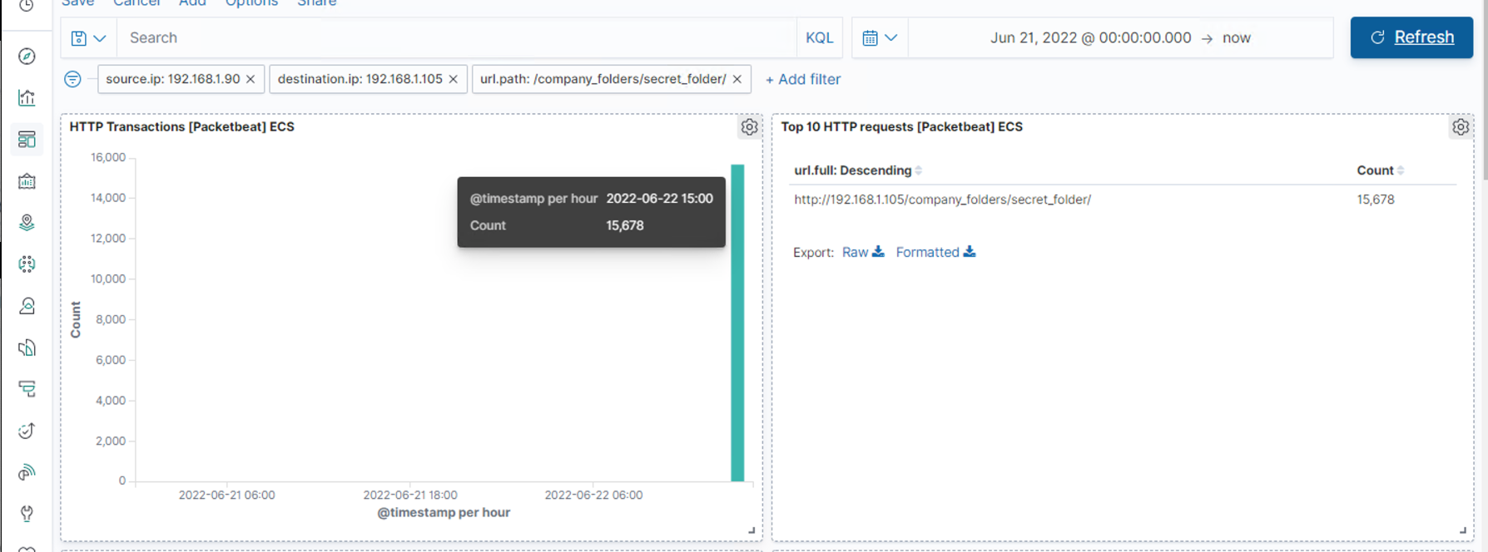
Analysis: Finding the Request for the Hidden Directory
The request was done close to the time of the port scan on June 22, 2022 around 3pm. With 15,678 requested being made for access to http://192.168.1.105/company_folders/secret_folder
This folder contained a hash password and clue on how to access the system using another employee’s credentials(Ryan)
[Insert Here]
Include a screenshot of Kibana logs depicting the request for the hidden directory.

Slide 16
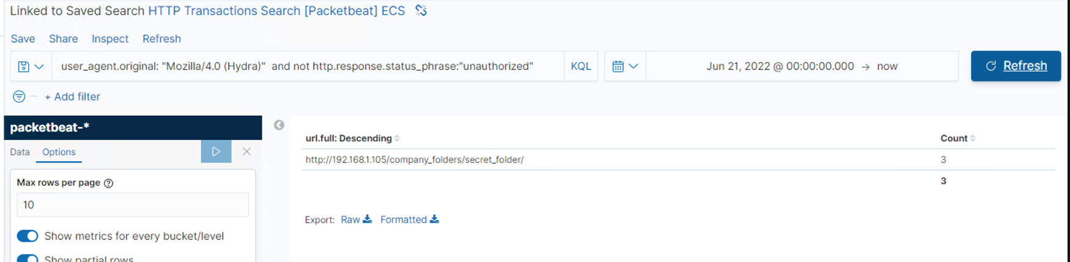
Analysis: Uncovering the Brute Force Attack
There was a total of 15,678 count to access the secret_folder, with 3 count of the http:response status as “authorized”
[Insert Here]

Slide 17
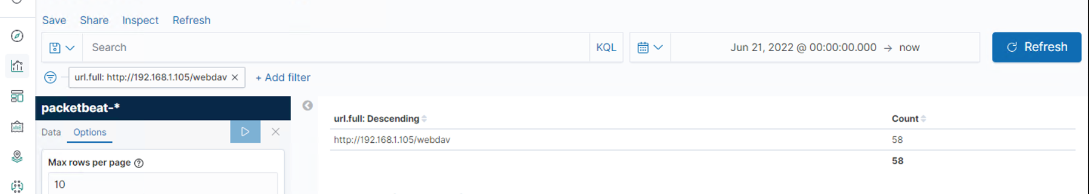
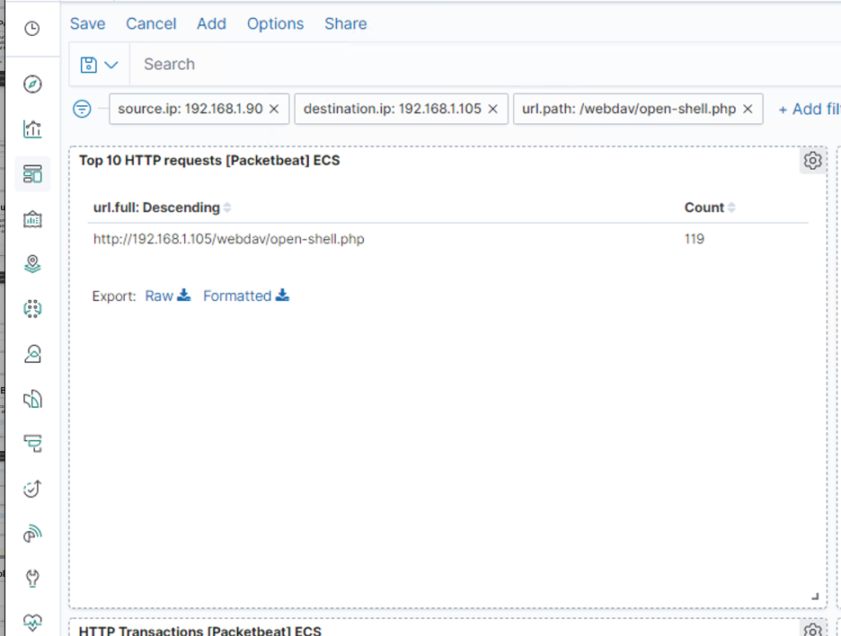
Analysis: Finding the WebDAV Connection
http://192.168.1.105/webdav has 58 count of requests.
With the open-shell.php being the primary requests.

Slide 18
Blue Team
Proposed Alarms and Mitigation Strategies
‹#›

Slide 19
Mitigation: Blocking the Port Scan
Having a threshold of 10 ports scans for low-level alert, and anything more than 100 will come with a severe alerts that need the IT department to look into.
Enable only traffic from certain IP addresses that can access internal hosts.
Password policy of 5 allowed failed login, otherwise redirected to IT department.
Educated employees on the risk of cyber hackers and make sure that all employee understand the correct process of login.
All employee will have their own login informations, and can not shared with others.

Slide 20
Mitigation: Finding the Request for the Hidden Directory
Low-level alert for 3 login failures.
Critical alert for more than 3 fail attempts.
Alert from non-authorized IPs.
Complex username and password.
Force password reset every 3 months.
Limit user access to directory
Removed all reference to the directory in the web server.
Able multi-factor authentication.
Blacklist IP after 3 failed login and can only be removed by IT department.

Slide 21
Mitigation: Preventing Brute Force Attacks
Alert for any value of ‘Hydra’
Low-level alert for 3 failed login
Critical alerts for 5 failed login
Alert from unfamiliar IP addresses
Account lockout after 5 failed login
Complex username and password
Password Expiry every 3 months.
Multi-factor authentication

Slide 22
Mitigation: Detecting the WebDAV Connection
Alert if from unfamiliar IP address
High Alert after 1 failed attempted
Limited user access to WebDAV
Complex username and password
Update to more secure application
Allowed only internal access from approved external connections.

Slide 23
Mitigation: Identifying Reverse Shell Uploads
High Alert for any ‘.php’ files.
Alert for all uploads that triggered anti-virus/anti-malware.
All alert has a threshold of 1.
Limited file types being uploaded.
Uploaded files is ‘Read-Only’ unless uploaded from company computer.

